Slide 1

STORE ANALYSIS REPORT

Slide 2
CHALLENGES FACED
Challenge of Loading Bulk Data
Performance Issues
Data Modeling
Complex Queries and Computations
Visualization Challenges

Slide 3
Key KPI’S
.
Number of Orders ( 96,000+ orders)
Number of Sellers ( 3,000+ sellers)
Number of Products (70+ products)
Total Payment Value ( 15 million+)

Slide 4
KPI 1 Weekday Vs Weekend Payment Statistics
.
Majority of the payments (approximately 77%) occur on weekdays.
A smaller percentage occur on weekends.
Weekends drive 3x more payments than weekdays.

Slide 5
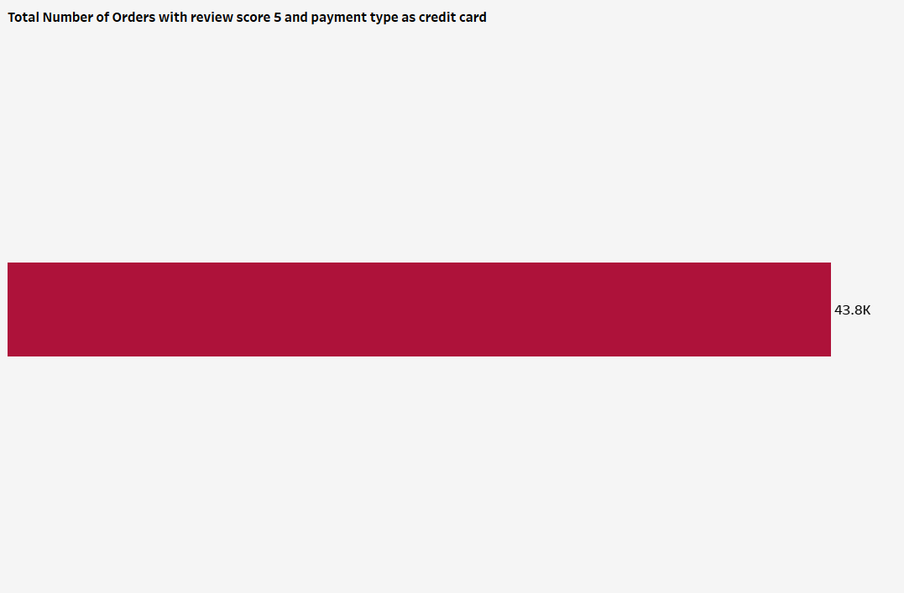
KPI 2 Total Number of Orders with review score 5 and payment type as credit card
.
High volume of credit card transactions often correlates with excellent customer reviews.
Indicates that customers using credit cards might be more satisfied or have better purchasing experiences..
Credit card users are 40% more likely to give 5-star reviews.

Slide 6
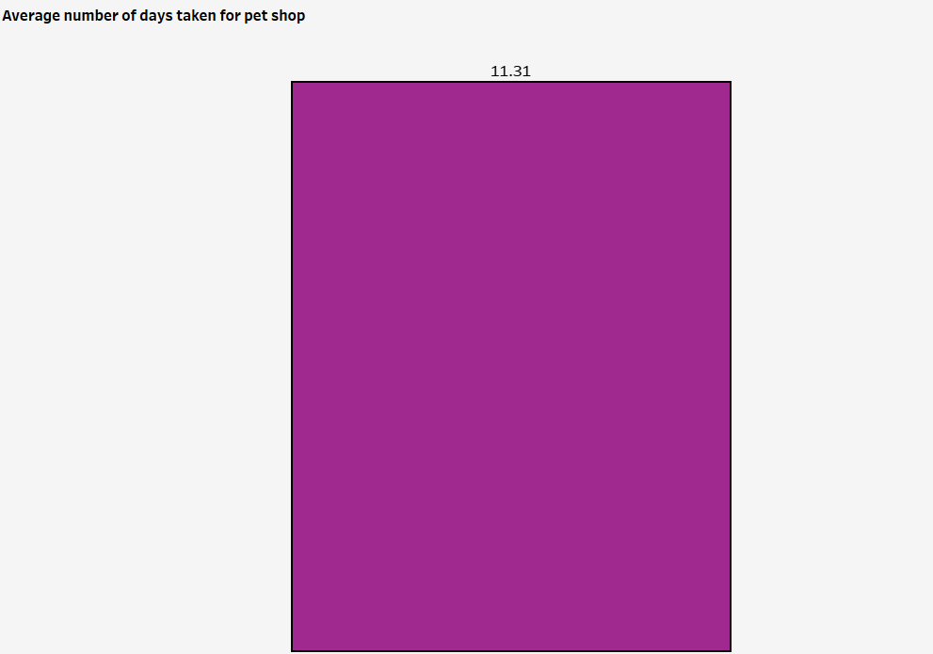
KPI 3 Average number of days taken for pet shop
.
Delivery times are around 11-12 days on average for pet shop, which could be longer than ideal for perishable or time-sensitive items..
Pet products take 25% longer to deliver.

Slide 7
KPI 4 Average price and payment values from customers of sao paulo city
Customers in São Paulo tend to pay higher on average, indicating a potential market with higher spending power.
This could be linked to higher disposable income or a preference for premium products..

Slide 8
KPI 5 Relationship between shipping days Vs average review scores.
Faster deliveries days generally receive higher review scores (around 4.3 to 5.0).
Longer delivery times see a noticeable decline in customer satisfaction and review scores drop to around (2.0–3.0)
Examines how different shipping durations impact customer review scores.

Slide 9
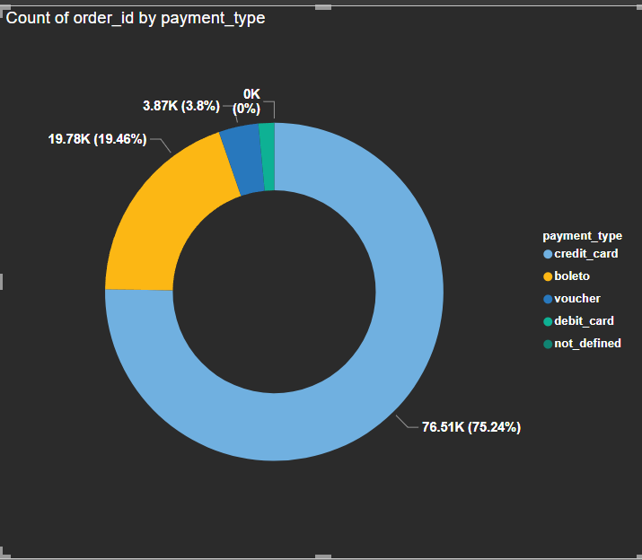
KPI 6 Total Orders vs. Payment Type
Credit cards are most preferred payment type with nearly 76%
Boleto users have nearly 20% followed by voucher and debit card.
Credit cards are the most trusted payment method for majority of customers.

Slide 10
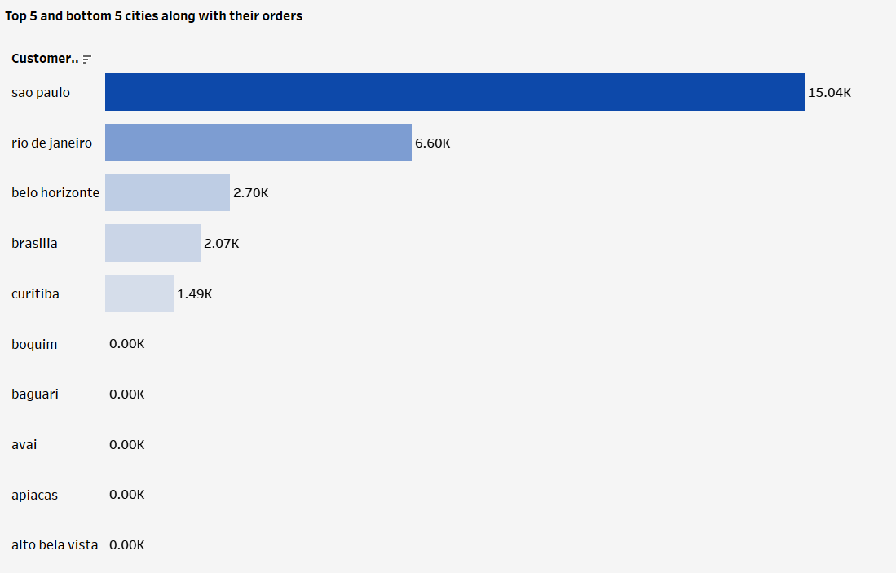
KPI 7 Top 5 and bottom 5 cities along with their orders
Cities with the highest and lowest order volumes (e.g., São Paulo, Rio de Janeiro, Belo Horizonte).Example Finding: São Paulo leads with 15K+ orders, while smaller cities have very few orders.

Slide 11
Insights from the Analysis
High Reliance on Weekdays: Most purchases (77%) occur on weekdays, suggesting strong weekday e-commerce traffic.
Credit Card Dominance: Over 70% of orders use credit cards, and they often correlate with high review scores.
Shipping Time Affects Reviews: Shorter delivery times (0–10 days) lead to better reviews (4+), indicating speed matters.
São Paulo as Key Market: Higher average payment values and large order volume from São Paulo.Pet Shop Delays
Pet shop deliveries take around 11–12 days, potentially impacting customer satisfaction.

Slide 12
Problem Statement
Weekday vs. weekend payment gap suggests missed weekend opportunities.
Identify why certain products/categories had low review scores.
Optimize delivery times to improve customer satisfaction.
Some product categories or cities have low transaction
Reduce dependency on credit cards and promote other payment methods.

Slide 13
RECOMMENDATIONS
Improve Logistics:
Partner with faster couriers or optimize shipping routes to reduce delivery days.
Weekend Promotions:
Offer weekend discounts or promotions to boost weekend sales.
Promote Credit Card Payments:
Since credit card orders often receive higher reviews, encourage customers to use credit cards.
Focus on Top Cities:
Tailor marketing for São Paulo and other high-order cities.
Inventory Planning:
Stock high-demand products (e.g., bed/bath, health/beauty) before.
Expand Business to Other Cities:
Capture untapped markets and drive overall sales growth

Slide 14


Slide 15
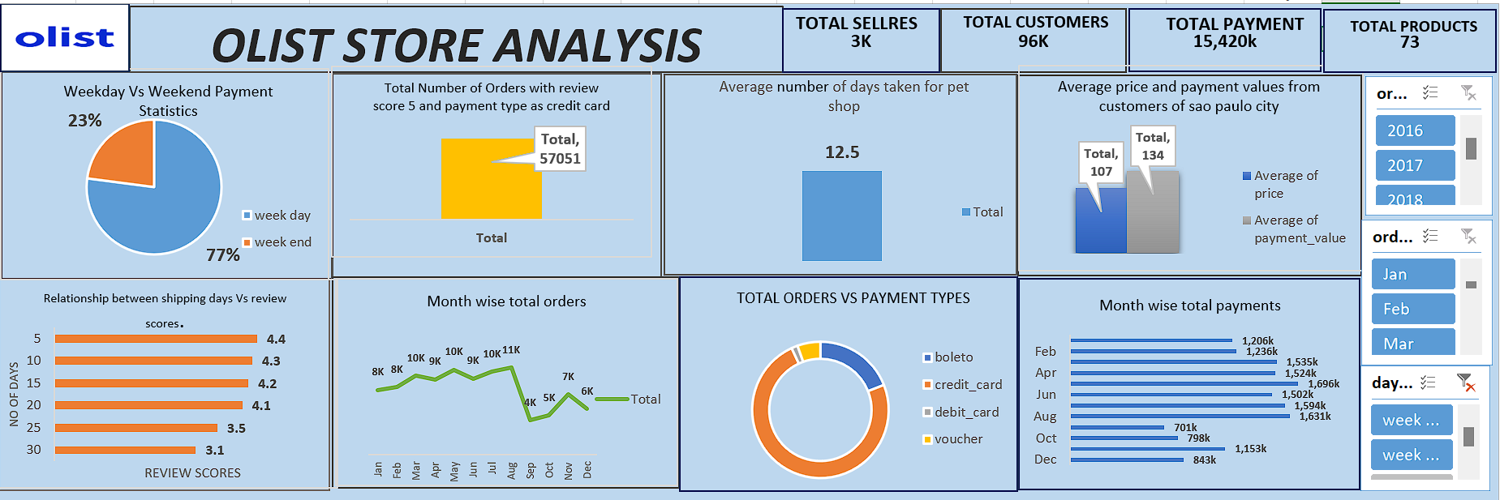
EXCEL DASH BOARD

Slide 16
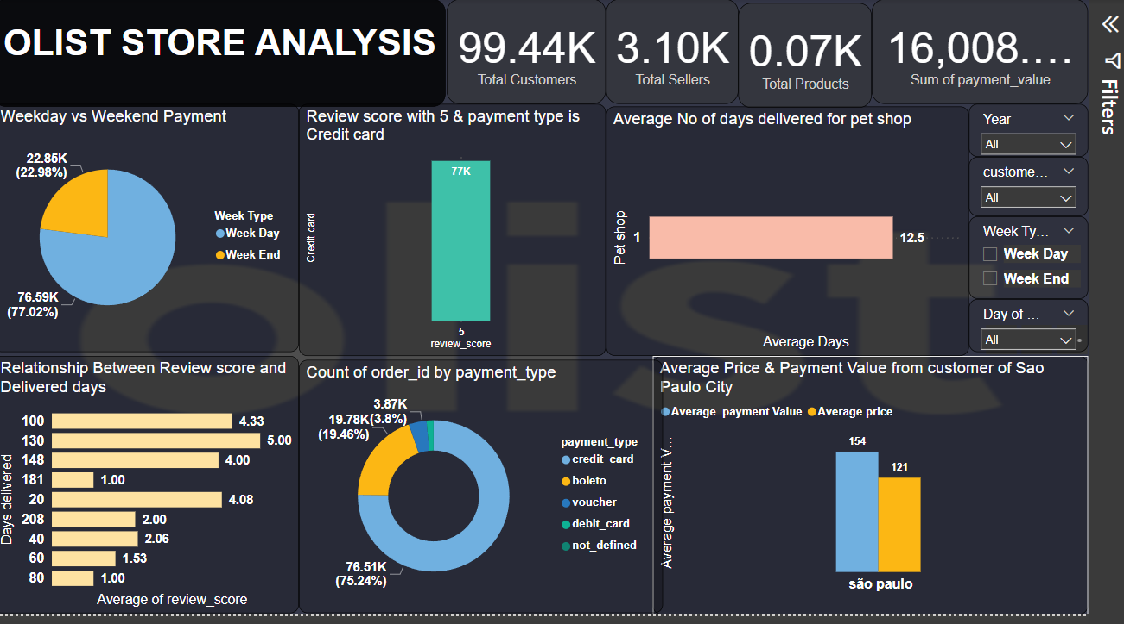
POWER BI DASH BOARD

Slide 17
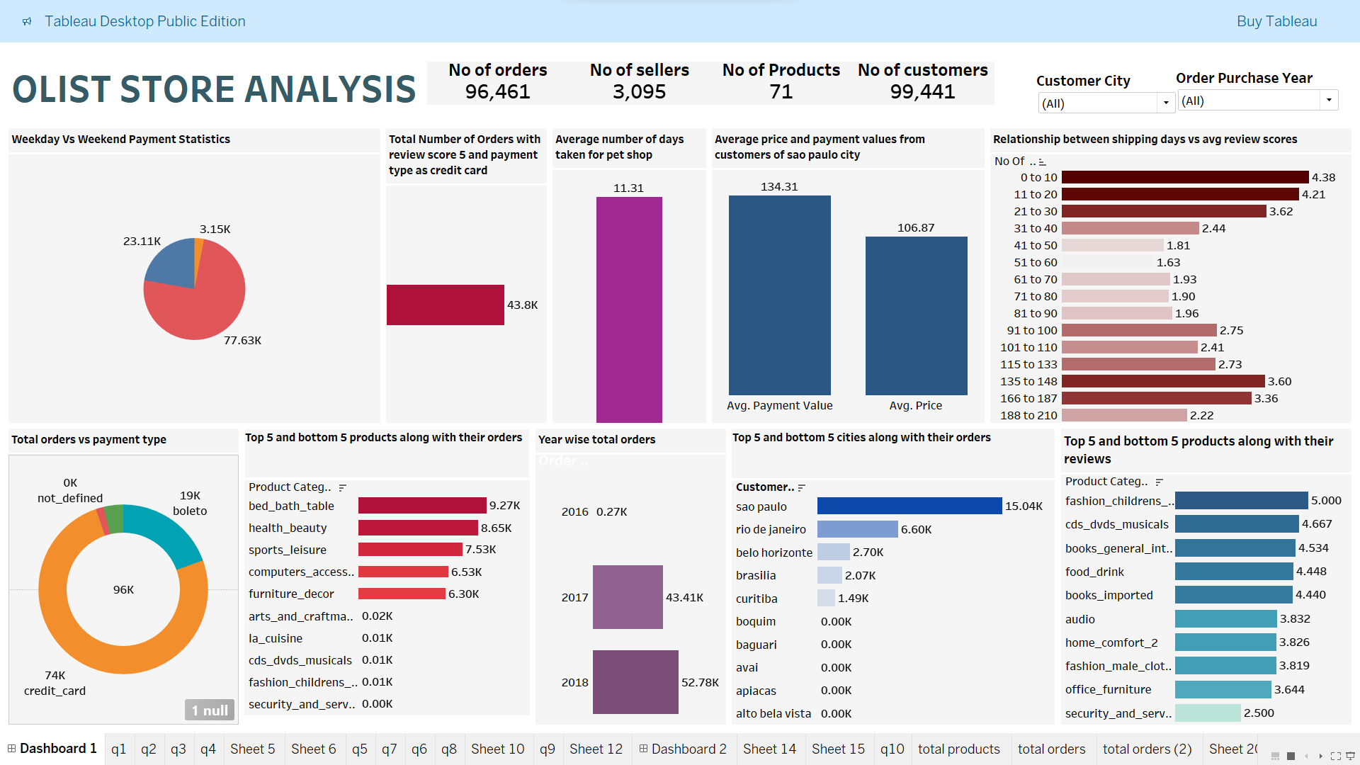
TABLEAU DASH BOARD

Slide 18
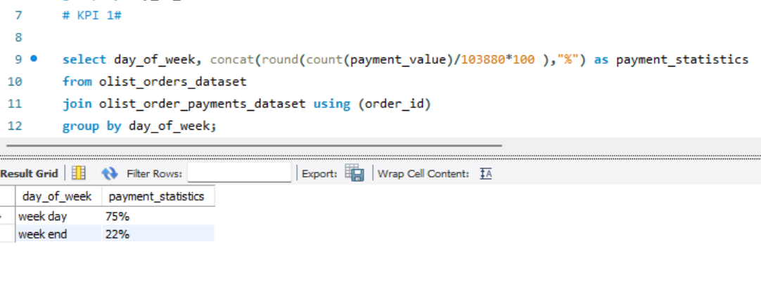
Weekday Vs Weekend Payment Statistics

Slide 19
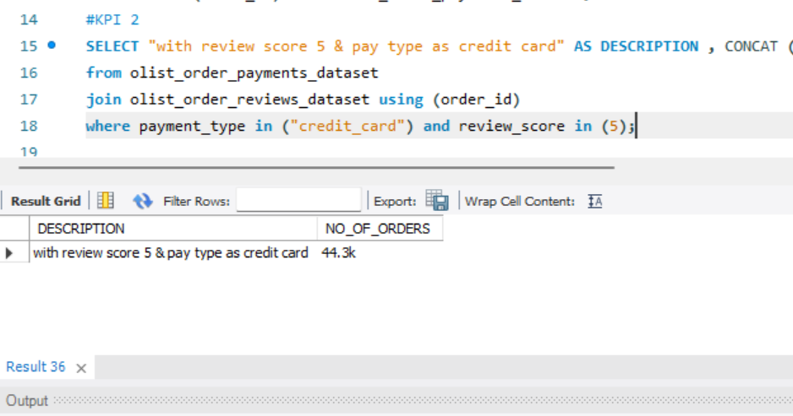
2) Number of Orders with review score 5 and payment type as credit card.

Slide 20
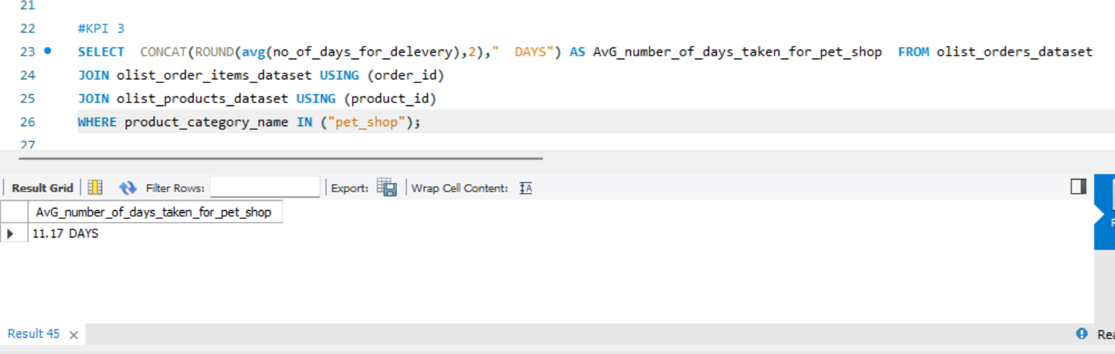
3) Average number of days taken for order_delivered_customer_date for pet_shop

Slide 21
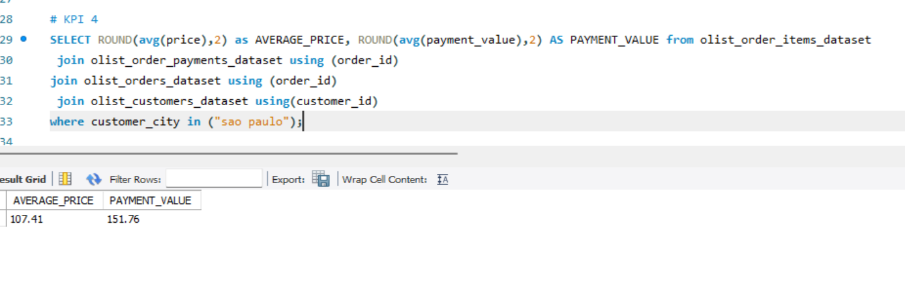
4) Average price and payment values from customers of sao paulo city

Slide 22
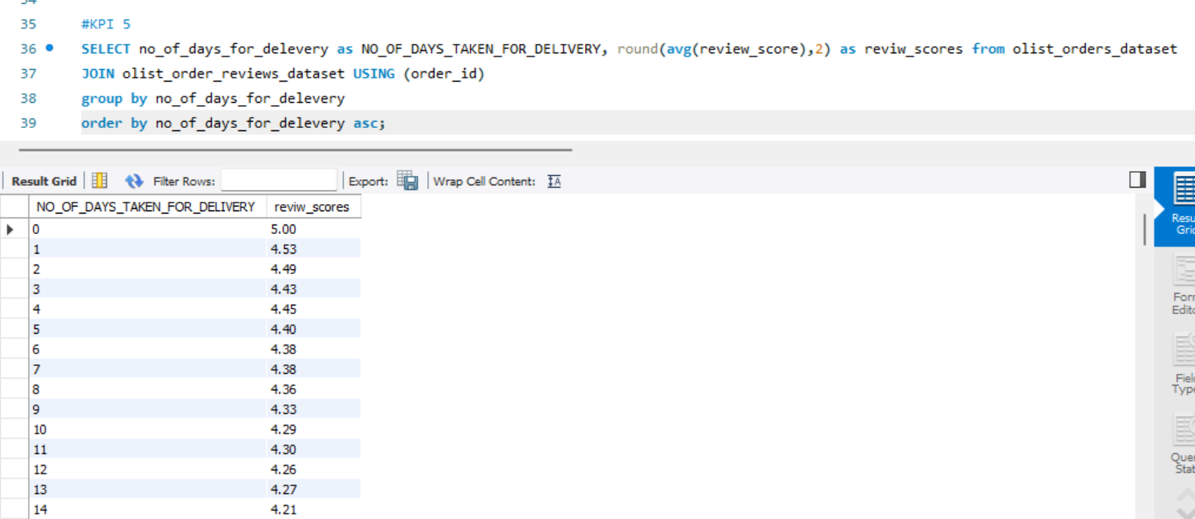
5) Relationship between shipping days Vs review scores.

Slide 23
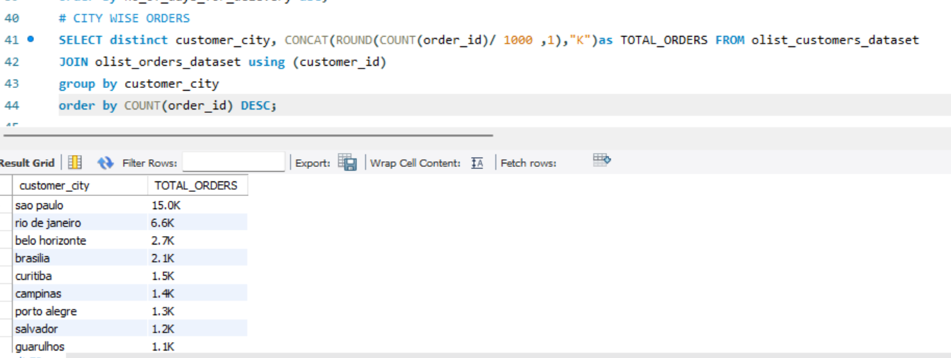

Slide 24
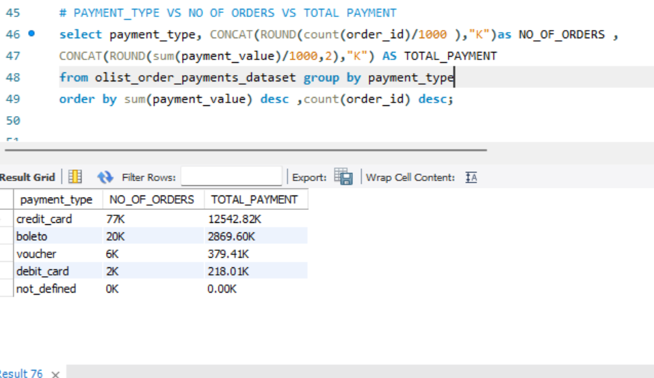

Slide 25
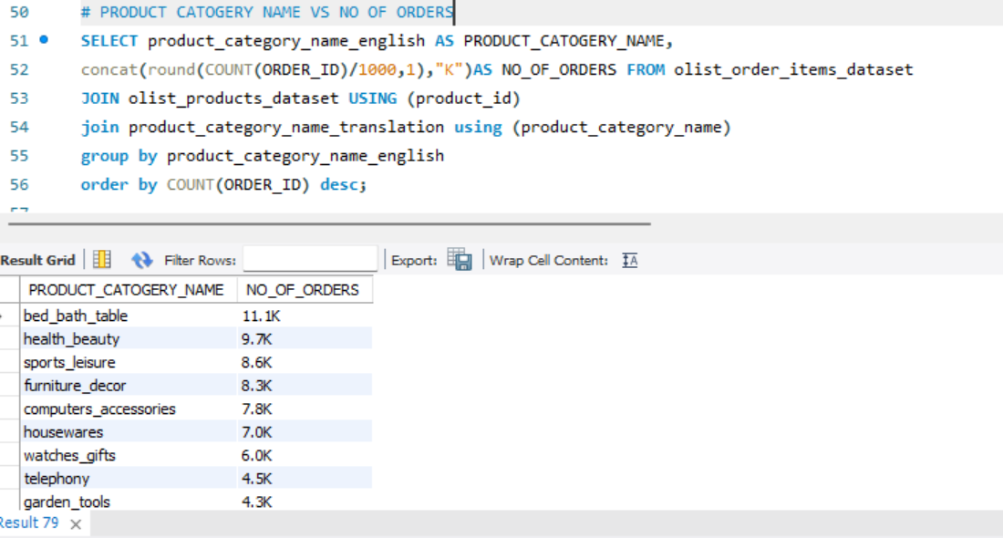

Slide 26
